Slide 1
Gödel to Turing to Chaitin to the Edge of Naturalism: Some Things Computers Will Never Do”
Robert J. Marks II
Distinguished Professor of Electrical and Computer Engineering

Slide 2
Abstract: Computing has no theory of everything (T.O.E.). We're uncertain whether physics has a T.O.E. as revealed in M-theory but, due to the genius of Kurt Gödel 75 years ago, smart people like Stephen Hawking are starting to doubt it. This is because of a new startling mathematical idea from algorithmic information theory (AIT): Building from Gödel’s work, there appear that many things exist that are true that cannot be derived from fundamental principles. Some things are true simply because they are true. Many claim God cannot be proved. (Although I'll show you Gödel’s short mathematical proof of God’s existence). There are some things we know exist that we can prove we will never know. Roger Penrose uses Gödel’s results to argue that humans are not computers (Turing machines). Most doubt a computer program will ever write a deeply meaningful poem or a classic novel. How about something simpler? Can we look at an arbitrary computer program and decide whether or not it will ever print out the number 3? We can for some programs. But Alan Turing, the founder of computer science, proved it is impossible to write a program to analyze another arbitrary program to tell us whether or not a 3 will be printed. In fact, we can't write a computer program to determine anything another arbitrary computer program will do. (This is called Rice’s theorem.) To find out, we need to run the program. We can also prove there are numbers of finite precision numbers a computer can’t compute. One of these is Chaitin's number, an astonishing constant between zero and one we know exists. If we knew Chaitin's constant to finite precision - one single number - we could solve a many of open problems in mathematics. These include the Riemann hypothesis, Goldbach's conjecture and whether or not there is an odd perfect number. Chaitin’s constant exists, but we can prove we will never know it. These and other mind bending properties in the field of AIT seem too far fetched to be true, but with a minimum of math, I will convince you otherwise.

Slide 3
Questions...
Can anything be proved to be outside of reach of computers?
Can humans be shown to be computers?
Will we ever have a TOE in physics?
Are there numbers that can’t be computed?
Can we prove existence of the unprovable and the unknowable?

Slide 4
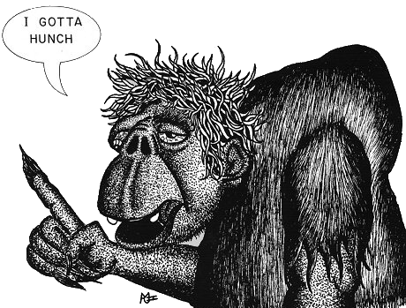
What Might Be Unprovable?
Goldbach’s Conjecture
All even numbers greater than 4 can be expressed as the sum of two prime numbers.
For example:
24 = 17 + 7
100 = 97 + 3
150 = 139 + 11

Slide 5
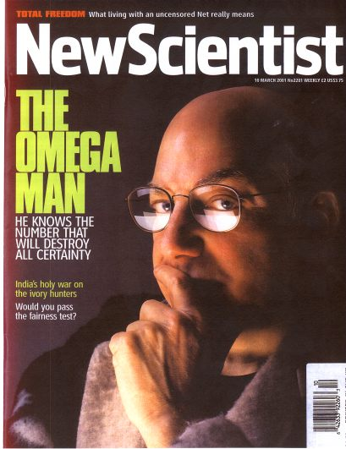
Chaitin’s Incredible Number
Ω = Chaitin’s number
= A number between zero and one.
If we knew Chaitin’s number, to finite precision, we could prove (or disprove) most unproven problems in mathematics, including Goldbach’s conjecture.
Gregory Chaitin
MATLAB has a value of Ω. C++ has another value for Ω. So does Java.

Slide 6
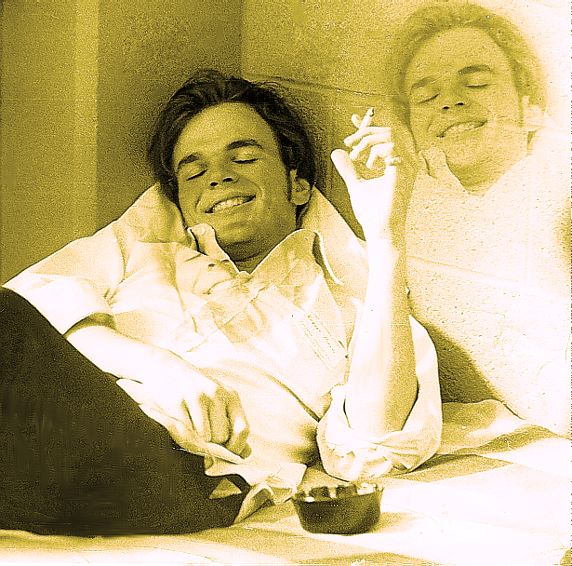
Meta Thought
Fun Meta Thoughts
Gödel’s Proof
Who was Gödel?
Turing Stop Test
Who Was Turing?
Ω: Chaiten’s number. A single number between one and zero we know exists that could be used to prove all theorems – but a number we will never know.
Numbers We Can’t Compute

Slide 7
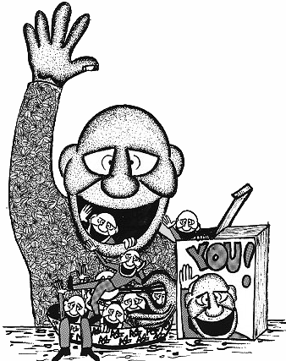
Meta Analysis
Meta = Self reference
It can be true:
“This sentence has five words.”
It can be false
“This sentence has twenty words.”
Meta Food: You is what you eat.

Slide 8
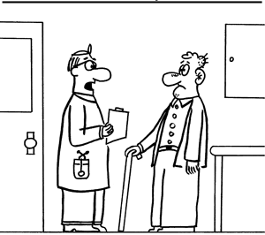
Meta Analysis can be Funny
“And if I don’t cure your amnesia, I will cheerfully refund all your doctor’s fees.”

Slide 9
Meta Statements Can Be Incomplete

Slide 10
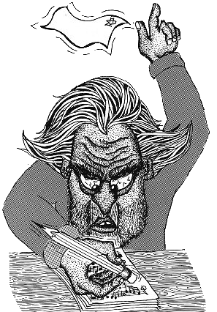
Meta Statements Can Have No Resolution
If you write a book about how to fail at selling books, and your book doesn’t sell, are you a failure?

Slide 11
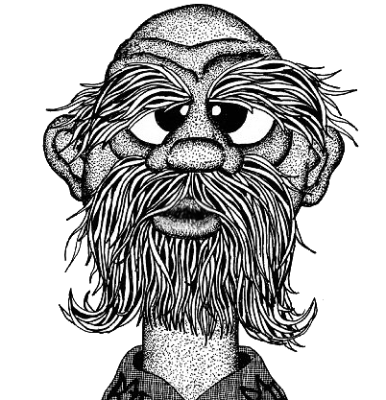
Meta Statements Can Be Bipolar
“The Cretians are alway liars.” Titus 1:12b
A Cretian
Everything I say is a lie.

Slide 12
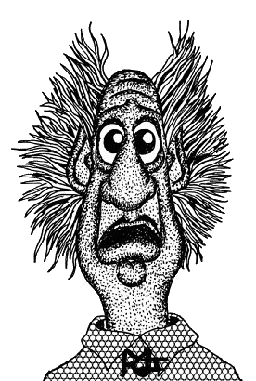
Meta Statements Can Be Curious
This statement is true!
This statement is true!
This statement is true!

Slide 13
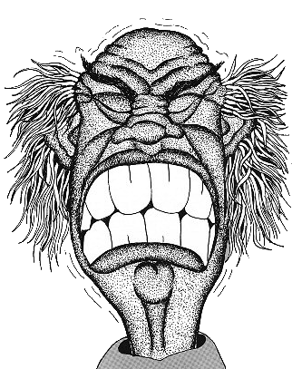
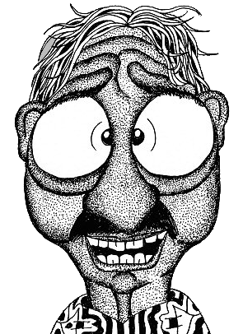
Meta Thought Can Reveal Self Refuting Philosophies
There is no absolute right and wrong. All is relative!
I disagree.
You’re wrong!
And you’re right?
Absolutely!

Slide 14
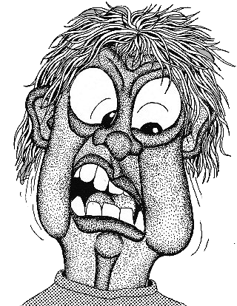
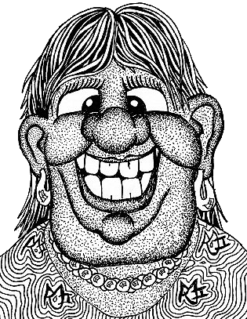
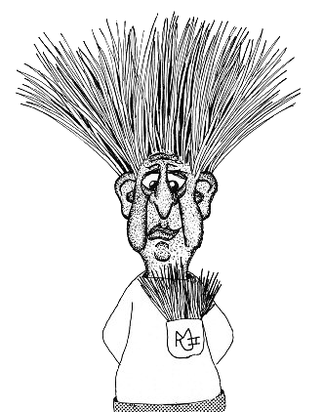
Meta Thought Can Reveal Numerous Self Refuting Philosophies
Only things proven by science can be believed.
Can you prove this scientifically?
I’m skeptical of all things
Are you skeptical of skepticism?

Slide 15
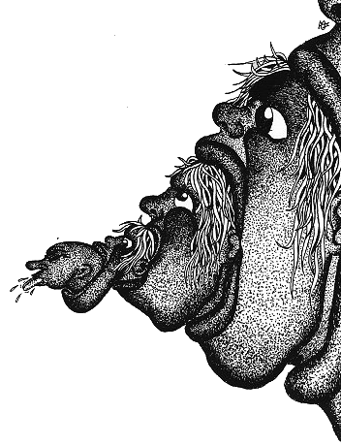
Meta Statements Can Require Clarifying Context
Mar 10:27b: ... with God all things are possible.
Is it possible to make something impossible?

Slide 16
THEOREM: All integers are interesting
PROOF
Assume there is a smallest uninteresting integer.
Hmmmm. That’s interesting!
Proof by contradiction.

Slide 17
Meta abilities separate Man from animals. C.S. Lewis, Mere Christianity
The Moral Law is evident by the meta ability of Man to externally examine instincts, feelings and inclinations and make meta moral decisions of right and wrong.

Slide 18
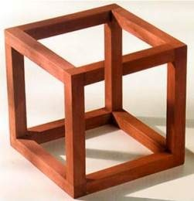
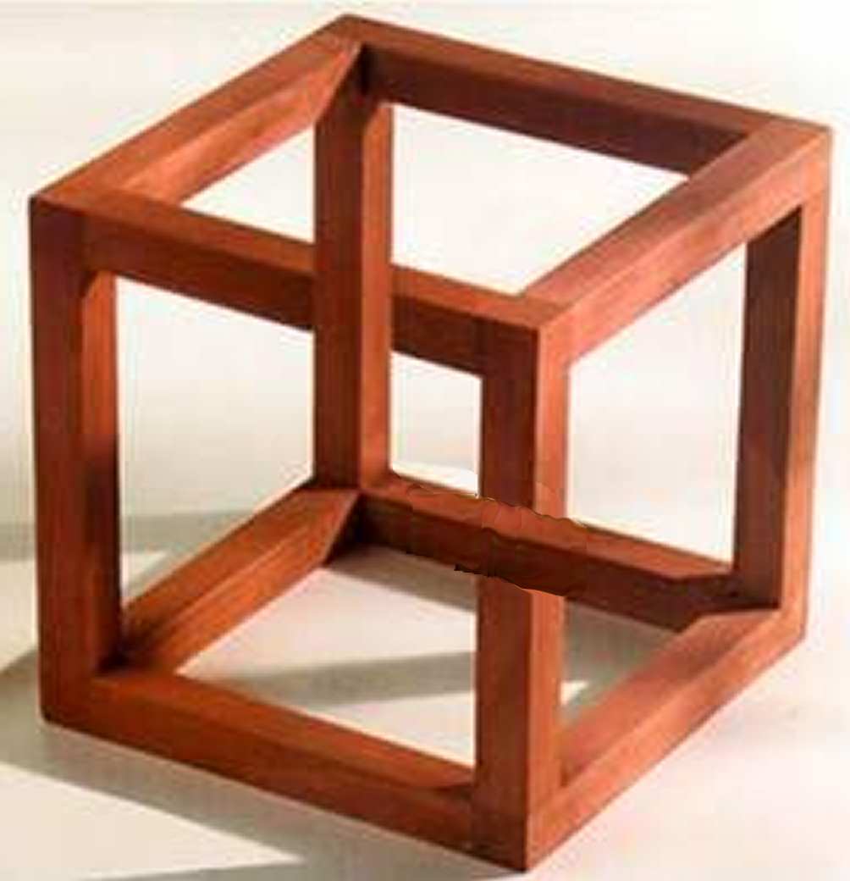
Berry’s Paradox
Let X be the smallest natural number that requires more than twenty words to define.
Paradox: “Let X be the smallest natural number that requires more than twenty words to define” defines X using 15 words.

Slide 19
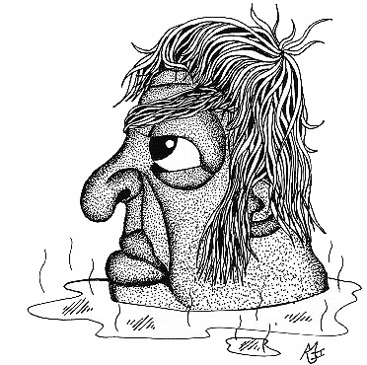
Things that Can’t Be Done include An “Elegant Program” Program
Write a program to evaluate all elegant programs (minimum Kolmogorov complexity) for a given computer output…
Elegant Program Generator (EPG)
Desired Output
Elegant program
The EPG takes B bits. Assume a desired output with an elegant program more B bits. If the EPG can generate an elegant program requiring more that B bits, we have a contradiction. The EPG is shorter than the elegant program . Therefore, the result cannot be the shortest program!

Slide 20
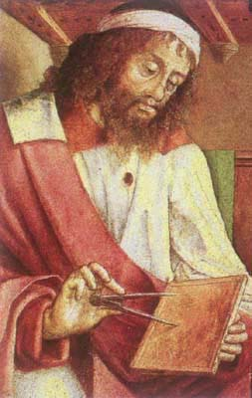
Meta Analysis on Euclid's Postulates (?????)
1. A straight line segment can be drawn joining any two points.
2. Any straight line segment can be extended indefinitely in a straight line.
3. Given any straight line segment, a circle can be drawn having the segment as radius and one endpoint as center.
4. All right angles are congruent.
5. If two lines are drawn which intersect a third in such a way that the sum of the inner angles on one side is less than two right angles, then the two lines inevitably must intersect each other on that side if extended far enough.

Slide 21
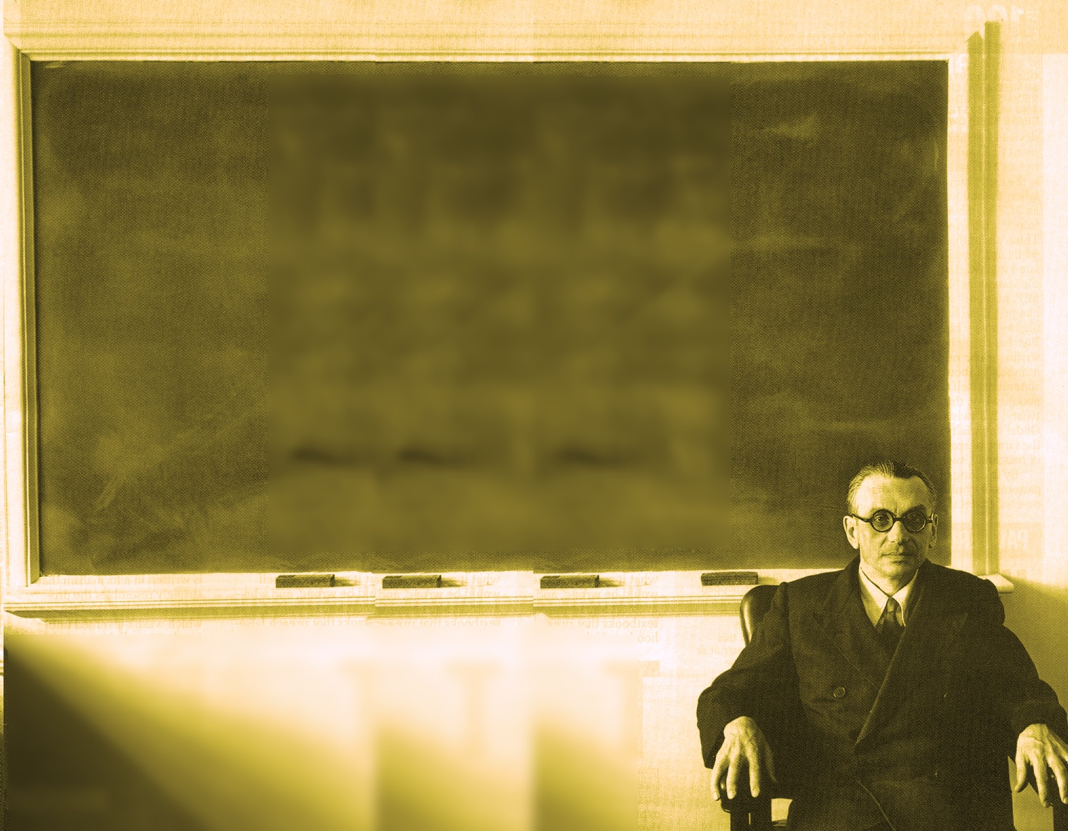
Meta Thought Can Topple Mathematical Disciplines
Gödel’s Proof (1931) showed , from any set of assumptions, there are truths that cannot be proven.
Kurt Gödel (1906 - 1978)

Slide 22
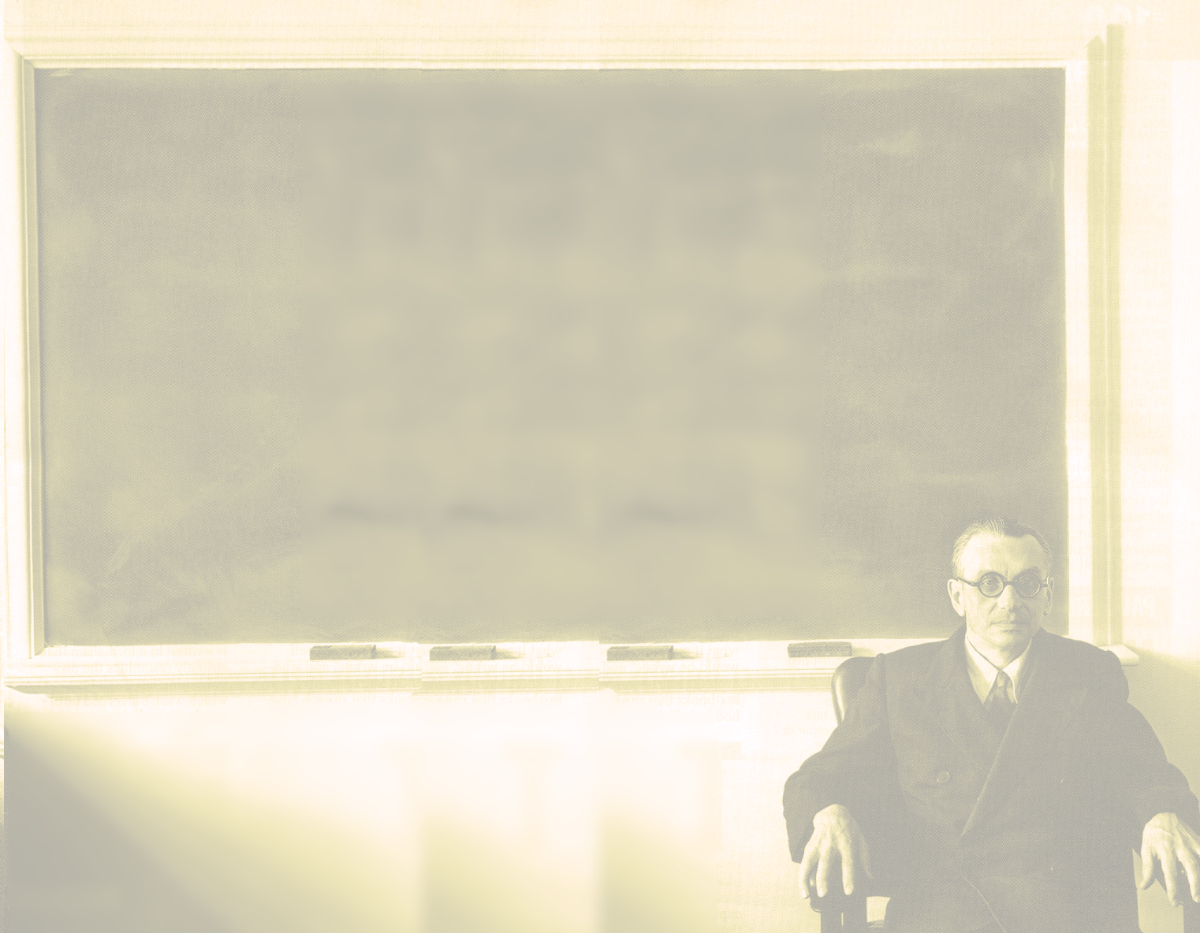
Time Magazine’s Top 100 Persons of the Twentieth Century
Scientists & Thinkers
• Leo Baekeland (1863-1944), Belgian-American chemist who invented Bakelite
• Tim Berners-Lee (b. 1955), inventor of the World Wide Web
• Rachel Carson (1907-1964), American marine biologist
• Francis Crick (1916-2004) and James D. Watson (b. 1928), Scientists who discovered the DNA structure
• Albert Einstein (1879-1955), German-born theoretical physicist, author of the theory of relativity
• Philo Farnsworth (1906-1971), American inventor who invented the electronic television
• Enrico Fermi (1901-1954), Italian physicist, most noted for his work on the development of the first nuclear reactor
• Alexander Fleming (1881-1955), Scottish biologist and pharmacologist, he discovered the penicillin
• Sigmund Freud (1856-1939), Austrian neurologist and psychiatrist, founder of psychoanalytic school of psychology
• Robert Goddard (1882-1945), American professor and scientist, pioneer of controlled, liquid-fueled rocketry
• Kurt Gödel
• Edwin Hubble (1889-1953), American astronomer
• John Maynard Keynes (1883-1946), British economist
• Louis (1903-1972), Mary (1913-1996) and Richard Leakey (b. 1944), British and Kenyan archaeologists
• Jean Piaget (1896-1980), Swiss philosopher, natural scientist and developmental psychologist
• Jonas Salk (1914-1995), American physician and researcher developed of the first successful polio vaccine
• William Shockley (1910-1989), British-born American physicist who invented the transistor
• Alan Turing
• Ludwig Wittgenstein (1889-1951), Austrian philosopher
• Wilbur (1867-1912) and Orville Wright (1871-1948), builders of the world's first successful airplane
(1906-1978), Austrian-American mathematician & philosopher
(1912-1954), English mathematician, logician & cryptographer
http://en.wikipedia.org/wiki/Time_100:_The_Most_Important_People_of_the_Century

Slide 23
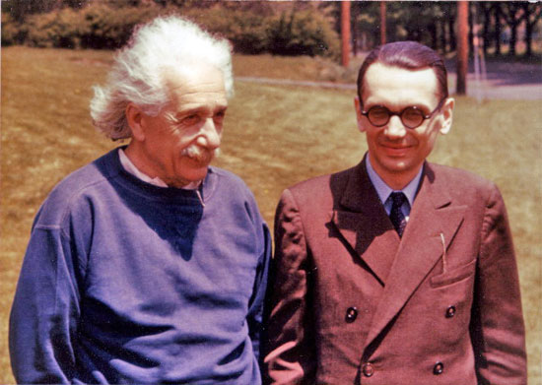
Gödel With Einstein at the Princeton Institute

Slide 24
Gödel’s View on Evolutionary Informatics [EvoInfo.org]...
“The formation in geological time of the human body by the laws of physics (or any other laws of similar nature), starting from a random distribution of elementary particles and the field is as unlikely as the separation of the atmosphere into its components. The complexity of the living things has to be present within the material [from which they are derived] or in the laws [governing their formation]”
H. Wang. “On `computabilism’ and physicalism: Some Problems.” in Nature’s Imagination, J. Cornwall, Ed, pp.161-189, Oxford University Press (1995).

Slide 25
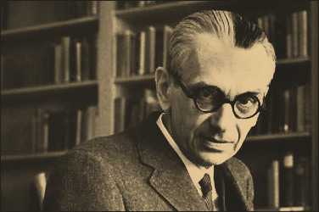
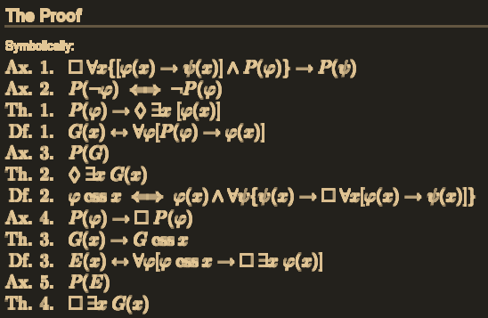
Gödel offered an ontological proof that God exists
http://en.wikipedia.org/wiki/G%C3%B6del's_ontological_proof

Slide 26
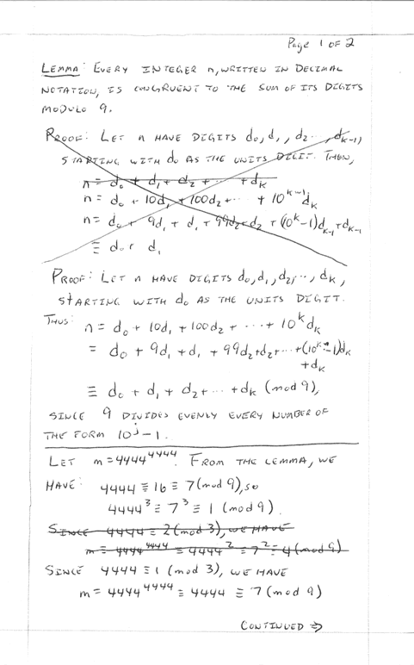
Gödel’s Proof Oversimplified
Theorem X:
Theorem X cannot be proved.
For any theory...
If we don’t prove Theorem X, the system is INCOMPLETE.
If we prove Theorem X, the system is INCONSISTENT.

Slide 27
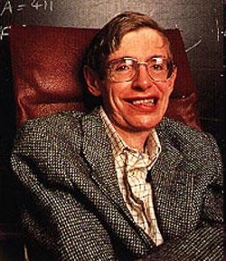
Stephen Hawking "Gödel and the end of physics“ http://www.damtp.cam.ac.uk/strings02/dirac/hawking/
Consequences
“Up to now, most people have implicitly assumed that there is an ultimate theory, that we will eventually discover. Indeed, I myself have suggested we might find it quite soon. However, M-theory has made me wonder if this is true. Maybe it is not possible to formulate the theory of the universe in a finite number of statements. This is very reminiscent of [sic] Goedel's theorem. This says that any finite system of [sic] axyoms, is not sufficient to prove every result in mathematics.”
Feb 23, 2004

Slide 28
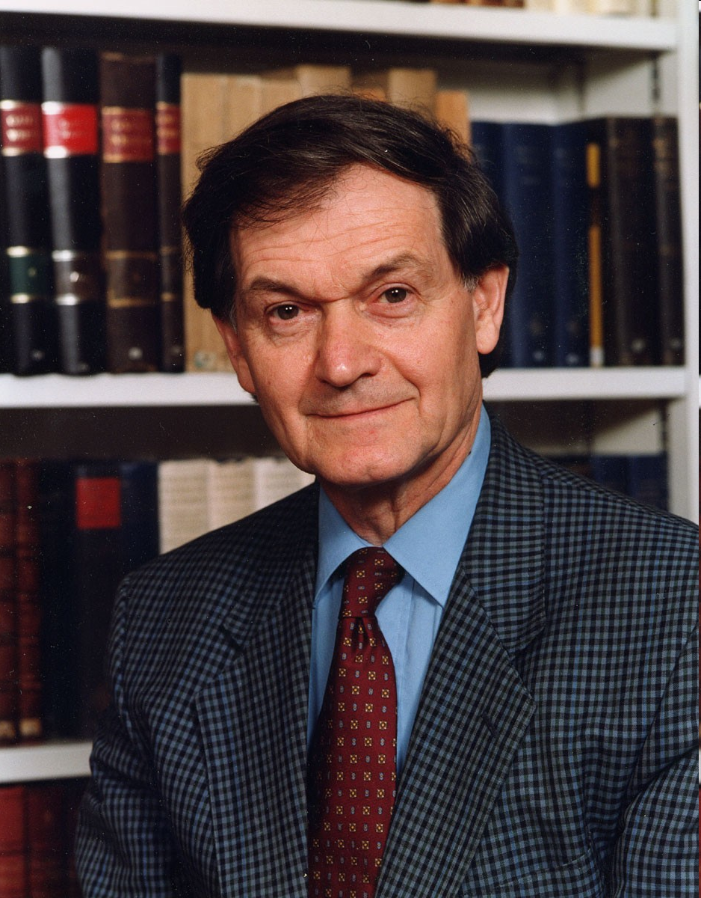
Roger Penrose: Gödel Shows Humans are Not Computers (Turing Machines)
Consequences
Penrose’s idea: Gödel's proof of his first incompleteness theorem shows that human mathematics cannot be captured by a formal system F: the Gödel sentence G(F) of F can be proved by a (human) mathematician but is not provable in F.

Slide 29
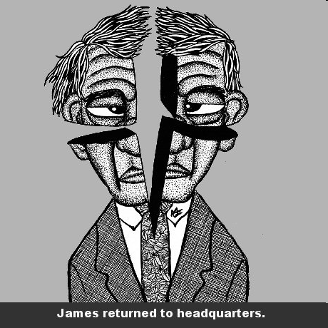
What Might Be Unprovable?
The Fours is Strong!
11 > ELEVEN > 6
6 > SIX > 3
3 > THREE > 5
5 > FIVE > 4
4 > FOUR >4

Slide 30
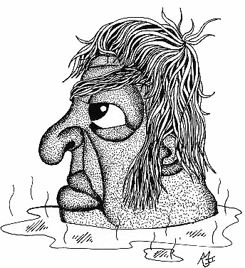
What Might Be Unprovable?
Goldbach’s Conjecture
All even numbers greater than 4 can be expressed as the sum of two prime numbers.
For example:
32 = 29 + 3
144 = 131 +13
8 = 5 + 3

Slide 31
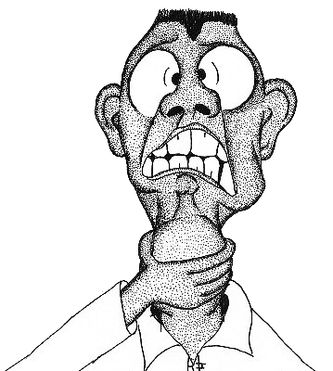
What Might Be Unprovable?
2. Is there an odd perfect number?
6 = 3 + 2 +1
28= 14 + 7 + 4 + 2 + 1
Euclid showed
N = 2^{n-1}(2^{n}-1)
is perfect when
2^{n}-1
is (Mersenne) prime.
44 known

Slide 32
What Might Be Unprovable?
3. Legendre's conjecture: Does there always exist at least one prime between consecutive perfect squares?
(3²,4²) =(9,16) → 11 is prime.
(8²,9²) =(64,81) → 71 is prime.
(11²,12²) =(121,144) → 131 is prime.

Slide 33
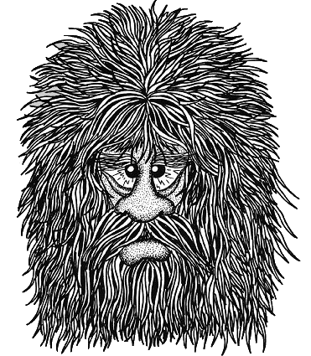
What Might Be Unprovable?
4. Collatz Conjecture (1937).
Does this iteration always go to 1?
a_{n+1} = a_{n} /2 if a_{n} is even
a_{n+1} = 3a_{n} +1 if a_{n} is odd

Slide 34
Collatz Conjecture for 1 to 20

Slide 35
Collatz Conjecture for 27

Slide 36
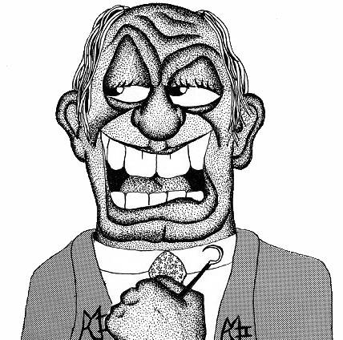
What Might Be Unprovable?
5. Gilbreath Conjecture (1958).
Repeated difference of primes…
2, 3, 5, 7, 11, 13, 17, 19, 23, 29, 31, ...
First Differences….
1, 2, 2, 4, 2, 4, 2, 4, 6, 2, ...
1, 0, 2, 2, 2, 2, 2, 2, 4, ...
1, 2, 0, 0, 0, 0, 0, 2, ...
1, 2, 0, 0, 0, 0, 2, ...
1, 2, 0, 0, 0, 2, ...
1, 2, 0, 0, 2, ...
Is the first number always one?

Slide 37
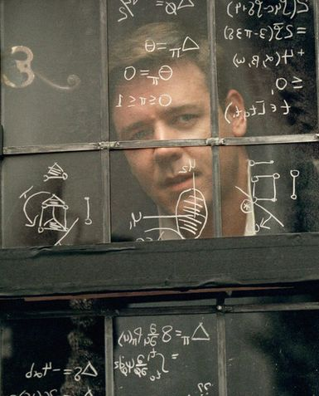
What Might Be Unprovable?
6. Riemann Hypothesis (1859). The real part of any non-trivial zero of the Riemann zeta function is ½.
Russell Crowe, as John Nash, discussed the Riemann Hypothesis in the motion picture “A Beautiful Mind.”
In 2004, Xavier Gourdon and Patrick Demichel verified the Riemann hypothesis through the first ten trillion non-trivial zeros .
A $1,000,000 prize has been offered by the Clay Mathematics Institute for the first correct proof of the Riemann hypothesis.
http://en.wikipedia.org/wiki/Riemann_hypothesis

Slide 38
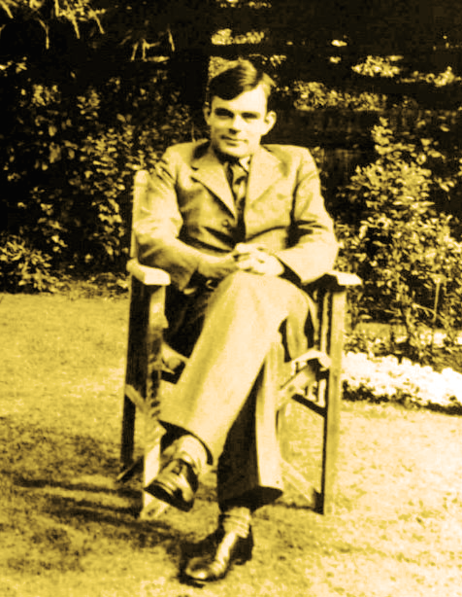
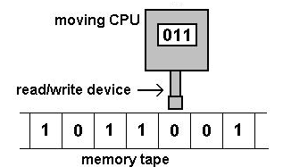
Alan Turing: Father of Modern Computer Science
The Turing Test
The Universal Turing Machine
Decrypted Enigma
The Turing Halting Problem
Alan Turing
(23 June 1912 – 7 June 1954)

Slide 39
Things that Can’t Be Done include An “Elegant Program” Program
Write a program to evaluate all elegant programs (minimum Kolmogorov complexity) for a given computer output…
Elegant Program Generator (EPG)
Desired Output
Elegant program
The EPG takes B bits. Assume a desired output with an elegant program more B bits. If the EPG can generate an elegant program requiring more that B bits, we have a contradiction. The EPG is shorter than the elegant program . Therefore, the result cannot be the shortest program!

Slide 40
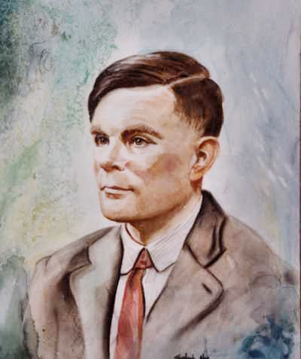
Alan Turing’s Private Life
Turing recognized his homosexuality as a teenager.
A boy at school to whom Turing was attracted suddenly died of bovine tuberculosis.
This loss shattered Turing's religious faith and led him into atheism and the conviction that all phenomena must have materialistic explanations. There was no soul in the machine nor any mind behind a brain. But how, then, did thought and consciousness arise?
After being arrested for homosexual acts, Turing committed suicide in 1954.
http://www.time.com/time/time100/scientist/profile/turing02.html

Slide 41
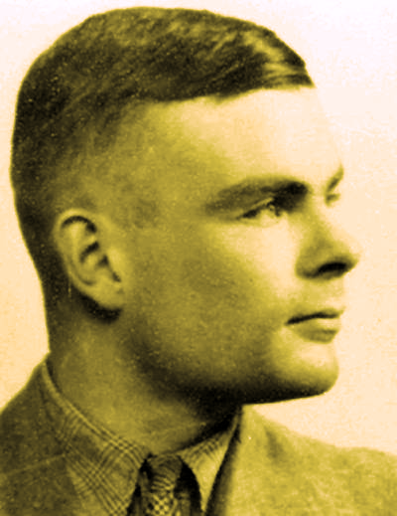
Gödel’s Proof Application & The Turing Halting Problem
Can we write a computer program to determine if another arbitrary computer program will ever stop?
Using Gödel’s proof, Turing showed this was not possible.
Turing

Slide 42
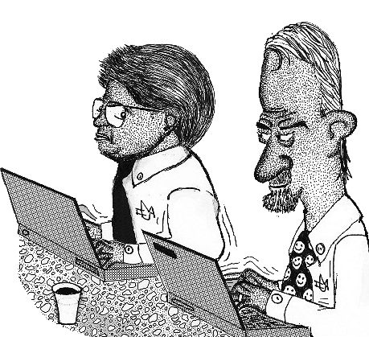
If we could solve the halting problem ...
We could find the answers to all open math theory.
For example, Goldbach’s Conjecture
How? Write a program to perform a sequential search, submit it to the “halting program”. If it halted, the conjecture is true. If not, it isn’t.

Slide 43
Proof of the Halting Theorem
Let p be a program with input i .
Both p and i can be expressed as a finite string of bits.
Assume there is a halting program, h.
the program halts
true
p,i
h(p,i)
the programdoesn’t halt
false

Slide 44
The Program t (for trouble) uses h
The program t , below, can be represented by a string of bits.
t(i)
loop forever
true
i
h(i,i)
false
stop
What happens when we input i = t ? ← A meta problem.

Slide 45
The Meta Paradox
t(t)
t(t) halts
t(t) doesn’t halt
loop forever
true
h(t,t)
t
false
stop
t(t) doesn’t halt
t(t) halts

Slide 46
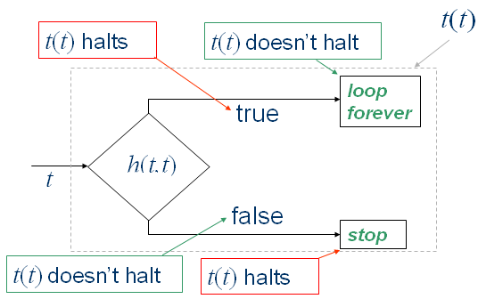
Quod erat demonstrandum...
Therefore, by reductio ad absurdum, there exists no halting program.

Slide 47
Halting Pseudocode
Arrange all programs p in a list starting with the smallest. The pth program is appropriately labeled as an integer p Let H(p,i) be a halting oracle program that decides if a program p with input i, written p(i) halts or not. H(p,i) outputs a 1 if the program p(i) halts and 0 if it doesn’t. Like programs, all possible inputs can be ordered and assigned an integer number, in this case i. Then, consider the program
function N(p) {
if(H(p,p) == 1) {
while(1 == 1) {
}
}
return 0;
}
Given a program p, this program outputs a 0 when p(p) doesn’t halt and runs forever in a while loop if the program p(p) halts. What, then, of the program N(N)? In this case, the program is analyzing itself to see whether of not it will halt. The results are contradictory. If H(N,N)=1 in the program, we get stuck in the while loop forever. But H(N,N)=1 means the program N(N) halts. This is a contradiction. Likewise, if If H(N,N)=0 in the program, a zero is printed and the program stops. But H(N,N)=0 means the program N(N) doesn’t halt. Another contradiction. Thus, the assumption there a halting program H(p,i) that works for all p and i has been proven false.

Slide 48
Hyper Computer: Assume a Halting Oracle
H(p,i): Does program p with input i halt?
i
p
NO:doesn’t halt
H(p,i)
YES:halts

Slide 49
Twin Prime Problem
To solve this, we need a Hyper-Halting Oracle
H₂(p,i)
Twin prime problem: (3,5),(5,7),…,(101,103)
Are there an infinite number of twin primes?
Initialize:i=(3,5)
i
Find the next twin prime.
i.e. Run p to find
i = next twin prime
p:
Search for next twin prime from i
H(p,i)
NO:doesn’t halt
YES:halts
Stop: There are a finite number of twin primes

Slide 50
Twin Prime Problem
Twin prime problem: (3,5), (5,7),…,(101,103)
Are there an infinite number of twin primes?
Hyper-Halting Oracle
H₂(p,i)
i₂={(2,4)}
Program p₂
p₂
i
Run p tofind the next twin prime
i = next k cousin prime
p:
Search for next twin prime from i
H₁(p,i)
NO:doesn’t halt
i₂
H₂(p,i)
YES:halts
No:
doesn’t halt.
Infinite # of twin primes.
Stop: There are a finite number twin primes
YES:halts
Finite # of twin primes

Slide 51
k Cousin Primes (same approach)
k = 6 cousin prime problem: (5,11),(7,13),…,(101,107)
Are there an infinite number of k = 6 cousin primes?
Hyper-Halting Oracle
H₂(p,i)
i₂={(1,k), k=6}
Program p₂
p₂
i
Find the next k cousin prime
i = next k cousin prime
p:
Search for next k cousin prime from i
H₁(p,i)
NO:doesn’t halt
i₂
H₂(p,i)
YES:halts
No:
doesn’t halt.
Infinite # of k cousin primes.
Stop: There are a finite number of k cousin primes
YES:halts
Finite # of k cousin primes

Slide 52
For k ≥ l ( l even), are all k-cousin primes finite in number?
Hyper²-Halting Oracle
H₃(p,i)
p₃: For k ≥ l cousin prime problem:
p₃
initia
-lize
k = l
Stop: Found a case of infinite k cousin primes, k ≥ l
p₂
i₃
H₃(p,i)
i₃= l
No:
doesn’t halt.
Infinite # of k cousin primes.
i₂ = k
H₂(p,i)
No:
doesn’t halt.
There is a k ≥ l with an infinite number of k-cousin primes.
YES:halts
Found a
case of infinite
k cousin primes,
k ≥ l
k=k+2
YES:halts
Finite # of
k cousin primes
Can do with
H₂(p,i)

Slide 53
Hyper^{n} Halting Oracle Regress…
p₃
p₅
i₃
p₇
H₃(p,i)
p₉
p₄
i₄
H₅(p,i)
i₇
p₁₀
p₆
H₇(p,i)
i₉
H₉(p,i)
p₈
i₁₀
H₁₀(p,i)
p₁₀
i₄
H₄(p,i)
i₆
i₈
H₈(p,i)
i₁₀
H₆(p,i)
H₁₀(p,i)

Slide 54
No meta program can predict what nontrivial program any arbitrary program will do.
Rice’s Theorem...
e.g. You can’t write a program to tell whether or not an arbitrary program will print the number 3
“Rice's theorem states that, for any non-trivial property of partial functions, there is no general and effective method to decide whether an algorithm computes a partial function with that property.”
Implications for determinism? (including quantum determinism?)

Slide 55
Prefix Free Codes
01
0
000
00
001
10000
11
11
1000
1
100
10001
10
1001
101

Slide 56
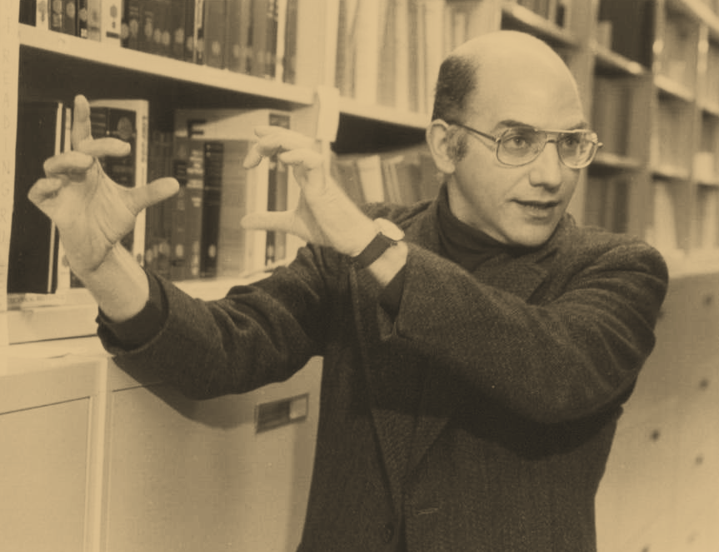
Chaitin’s Mystical, Magical Number.
Ω
Ω
Ω
Ω
Ω
Ω
Ω
Ω
Ω
Ω
Ω
Ω
Ω
Ω
Ω
Ω
Ω
Ω
Ω
Ω
Gregory Chaitin

Slide 57
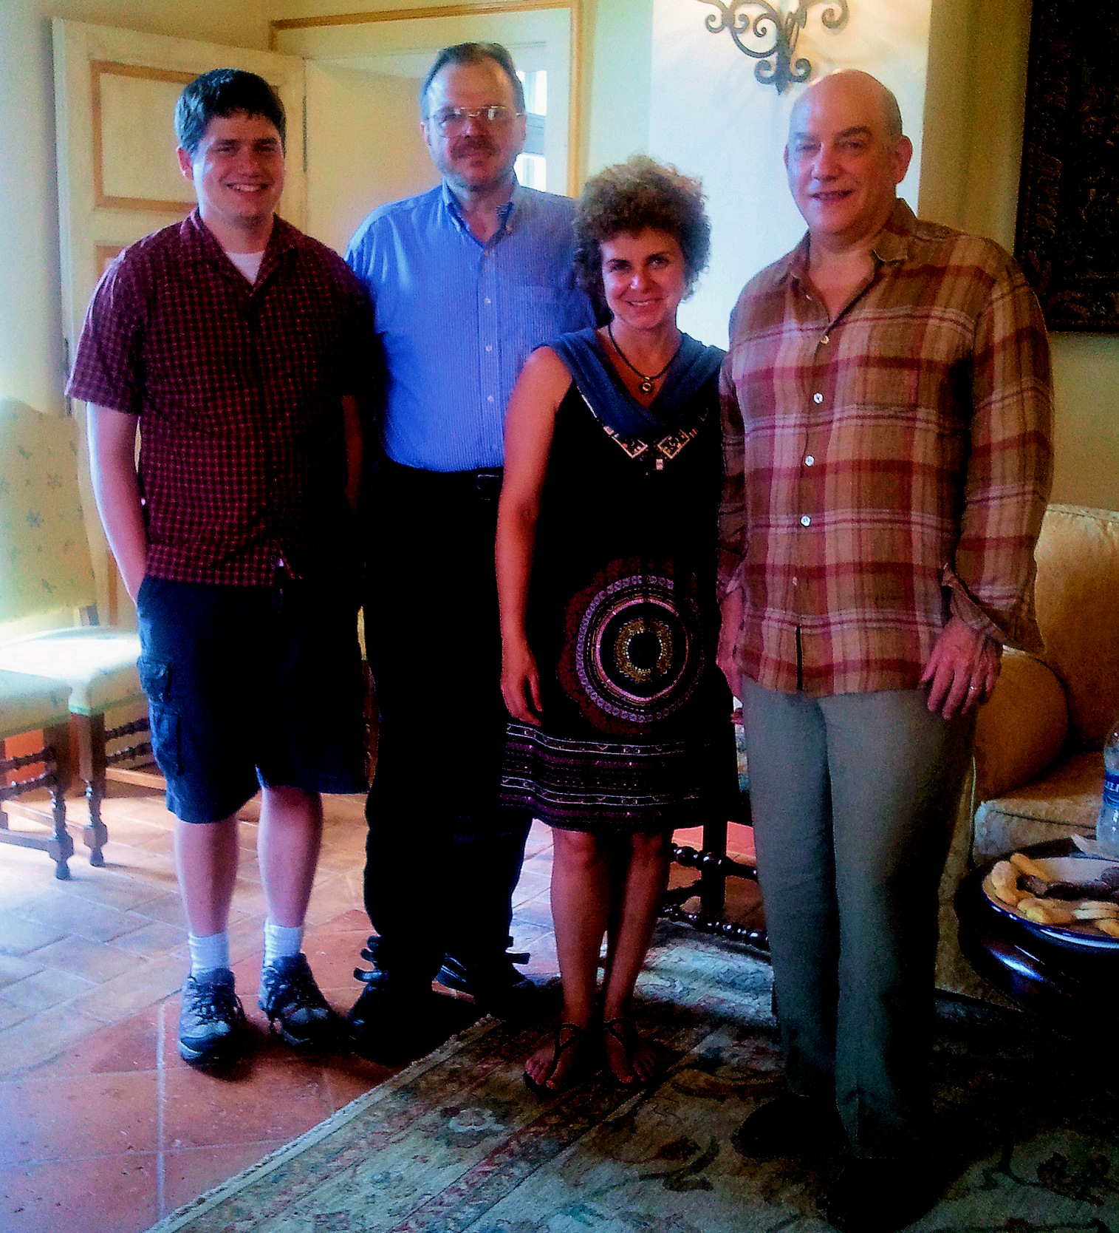
Ω
Dr. and Mrs. Gregory Chaitin with Winston Ewert & Robert Marks (Tuscany, Italy, 2011)
Ω

Slide 58
Chaitin’s Mystical, Magical Number, Ω. Kraft Inequality.
Length of Codewords
2, 3, 3, 3, 4, 5, 5
01
0
000
00
001
10000
11
11
1000
1
100
10001
10
1001
101
Note: 2⁻²+ 2⁻³+2⁻³+2⁻³+2⁻⁴+2⁻⁵+2⁻⁵= 1

Slide 59
Chaitin’s Mystical, Magical Number, Ω. Kraft Inequality.
01
Let the pth codeword be of length ℓ_{p}
0
000
00
001
10000
11
11
1000
1
100
10001
10
1001
101
Kraft Inequality:

Slide 60
Chaitin’s Mystical, Magical Number, Ω. Programs That Halt & Don’t
01
Some programs Halt and other’s Don’t Halt
0
000
00
001
100000
10000
11
1000
100001
1
100
10001
10
1001
101

Slide 61
Chaitin’s Mystical, Magical Number, Ω. Programs That Halt & Don’t
01
0
000
00
001
100000
10000
11
1000
100001
1
100
10001
10
1001
101
After time t, three of the programs have stopped.
Program 01 will never halt! Adding 2⁻² would exceed Chaitin’s number.

Slide 62
Chaitin’s Mystical, Magical Number, Ω. Programs That Halt & Don’t
01
0
000
00
001
100000
10000
11
1000
100001
1
100
10001
10
1001
101
Legendre's
conjecture
Goldbach’s conjecture
Goldbach’s conjecture will never halt!
Adding 2⁻⁴ =0.0675 will exceed Ω_{τ}
Odd perfect number

Slide 63
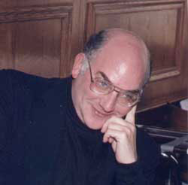
Chaitin’s Mystical, Magical Number, Ω.
Ω = Prob[ U(p) halts]
IF we knew Ω, we could know whether any program halted or not.
We could prove or disprove all theorems requiring a single counterexample.
Ω exists, but is unknowable.
Are there open math problems that would not be solved by Chaitin’s constant?
Gregory Chaitin

Slide 64
Hyper^{n} Halting Oracle Regress…
Chaitin’s Number Regress…
Ω = Ω₁ = Chaitin’s Number
p₁
Ω₃
p₃
i₁
p₅
H₁(p,i)
Ω₅
p₇
p₂
i₃
H₃(p,i)
Ω₇
i₅
p₉
p₄
H₅(p,i)
i₇
H₇(p,i)
p₆
i₉
H₉(p,i)
p₈
i₂
H₂(p,i)
i₄
i₆
H₆(p,i)
i₈
H₄(p,i)
H₈(p,i)
Ω₆
Ω₈
Ω₄
Ω₂

Slide 65
Chaitin’s number is not computable. A list of programs...
Lexicographical Ordering of Programs
01
11
000
001
1001
10001
100000
100001
01
0
000
00
001
10000
11
11
1000
1
100
10001
10
1001
101

Slide 66
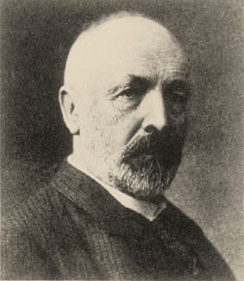
Chaitin’s number is not computable. A list of programs and outputs. Cantor diagonalization
Programs
01
11
000
001
1001
10001
100000
100001
Computable Numbers
0 0 1 1 0 0 0 1
1 0 1 0 1 1 0 0
0 1 1 1 0 0 1 0
1 0 1 0 1 0 0 1
0 0 1 - - - - -
1 0 0 1 1 0 1 0
0 0 1 0 0 - - -
1 0 0 1 1 1 1 1
1
1
0
1
0
Georg Cantor
(1845 - 1918)
1
This number is NOT COMPUTABLE
1
0
1 1 0 1 0 1 1 0

Slide 67
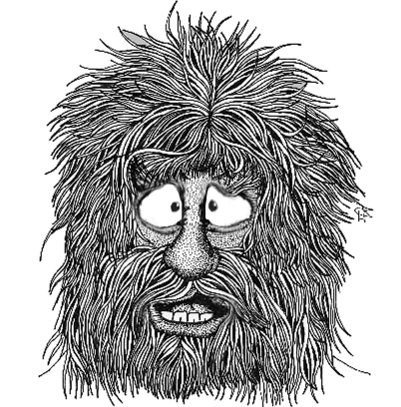
Astonishing Conclusion
There are things that are true and are known to exist that will never be proven nor computed.
What is not known forms an astonishing regress that becomes more and more difficult to comprehend.
Recall the preamble to Anselm’s ontological proof.

Slide 68
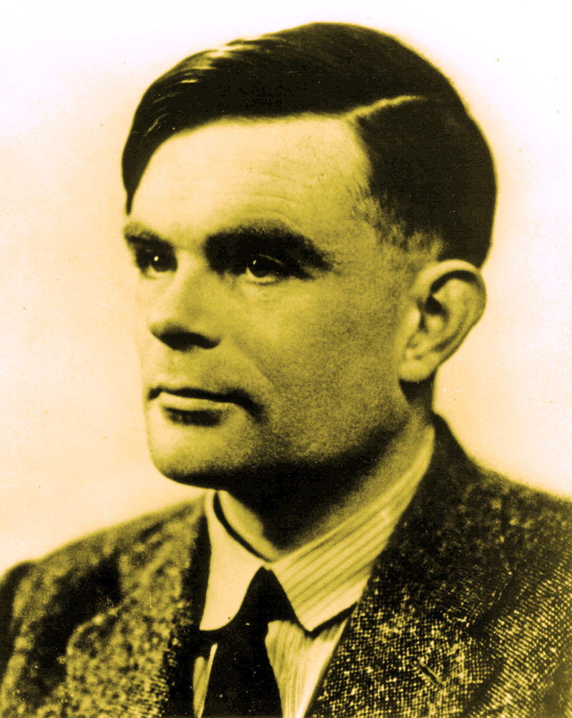
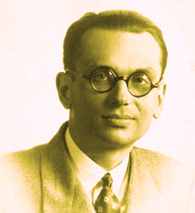
Gödel vs. Turing: A Contrast in World Views and Motivation
Materialist. Humans were fancy computers. His research was dedicated to proving this.
Deist. Did not believe in Darwinism. Worked on a mathematical proof of the existence of God.

Slide 69
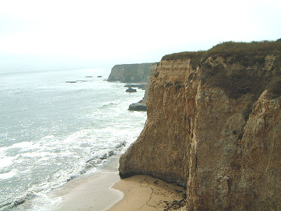

Slide 70
We are at an undisputed edge of naturalism.
☺
Does Science ever reach the edge of naturalism?
If so, will we ever know we are at the edge?
☹

Slide 71
Finis
Finis
Finis
Finis
Finis
Finis

