Slide 1
Mutual Information

Slide 2
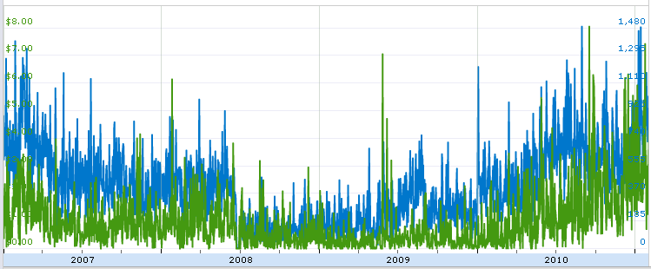
January 2007 through
December 2010
(1459 days)
Blue: X=Page Clicks
Green: Y= Income
Data: Google Adsense
Quantize Data: Page Clicks 100 and Daily Income, $1/3.
p(X,Y) = joint pdf
66 25 7 6 2 1 2 0 0 1
122 51 24 9 2 5 2 0 1 1
88 50 31 19 15 4 3 1 3 2
72 59 51 13 12 7 6 9 1 5
49 38 43 23 14 18 6 3 4 8
26 24 30 22 11 20 7 9 3 12
18 24 18 17 9 14 8 7 3 6
8 9 17 17 7 8 4 5 5 5
2 6 4 5 3 5 6 4 0 6
3 3 7 3 6 7 9 7 3 13

Slide 3
Marginal pdf’s
Joint pdf estimated from normalized histogram
Y
X
Joint Entropy
Marginal Entropy

Slide 4
Conditional Entropy
Mutual Information

