Slide 1
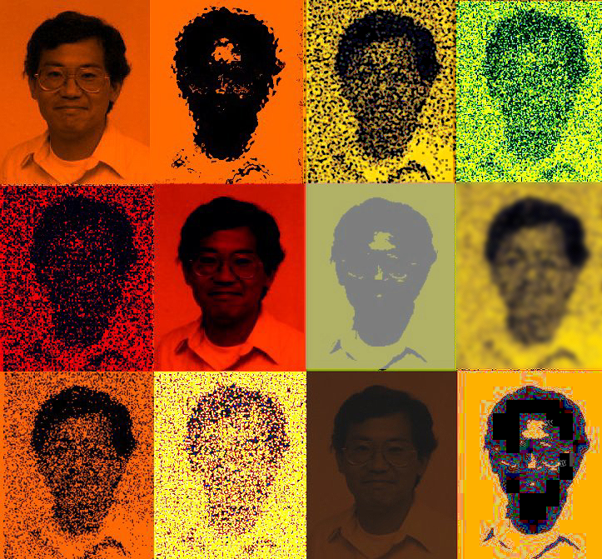
ECE 5354
Multiple Random Variables: Stochastic Resonance

Slide 2
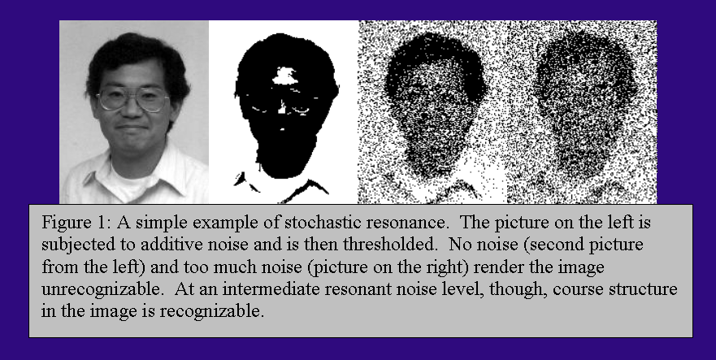
Stochastic Resonance
Stochastic resonance is loosely defined as the phenomena in a detection process wherein the addition of just the right amount and type of noise improves performance. Too little or too much noise result in degraded performance.

Slide 3
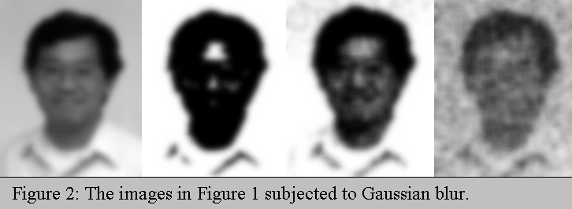
Stochastic Resonance
Too Little Noise
Just Right!
Too Much Noise

Slide 4
Stochastic Resonance
Dynamic Stochastic resonance
Squint Your Eyes
Original Image
Too Little Noise
Just Right!
Too Much Noise
http://cialab.ee.washington.edu/Presentations/StochasticResonance/home.html

Slide 5
Stochastic Resonance
Binary Stochastic Process
Signal
Threshold
Unit Step
Noise

Slide 6
Stochastic Resonance

Slide 7
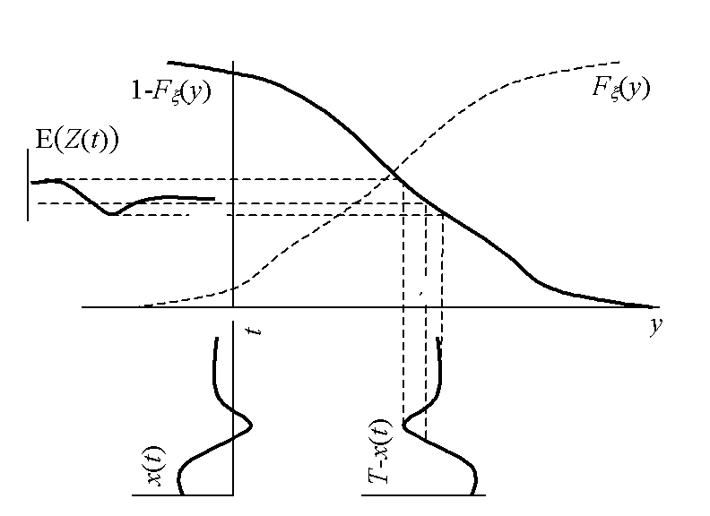
Stochastic Resonance:
The expected value is the signal run through a nonlinearity specified by the CDF of the noise.

Slide 8
Stochastic Resonance in Uniform Noise
The normalized histogram for E[Z(t)] is
where

Slide 9
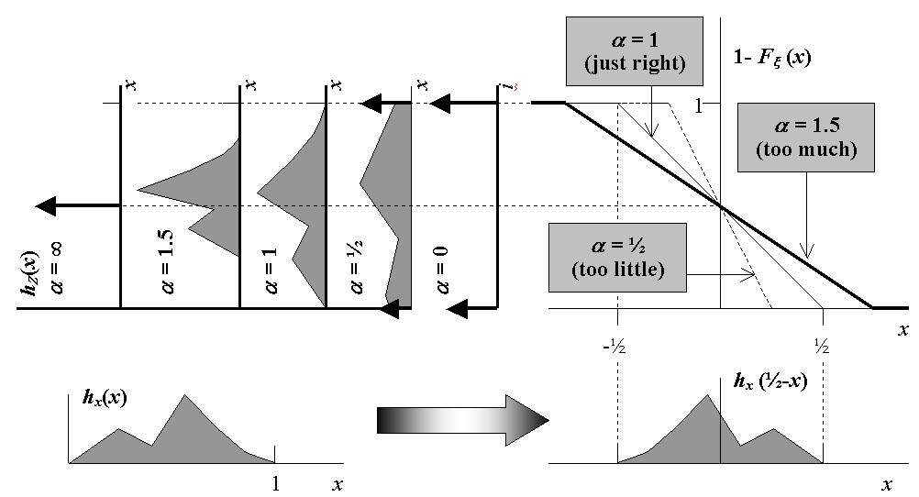
Stochastic Resonance in Uniform Noise
Correct value of α gives “exact” results!

Slide 10
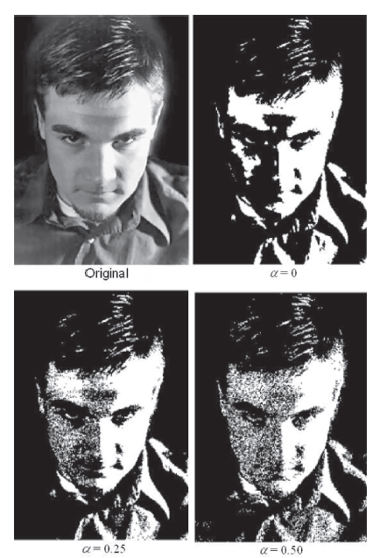
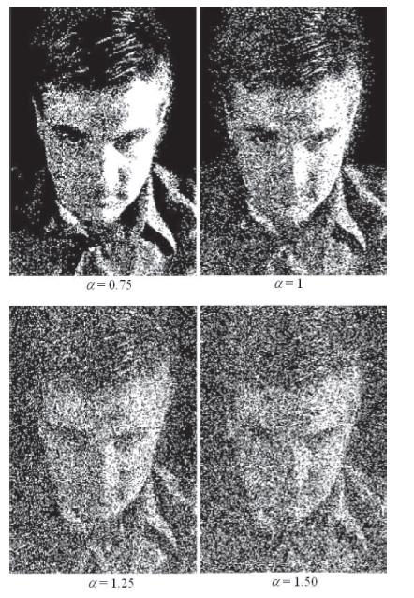
uniform noise: - α to α about 0.5

Slide 11
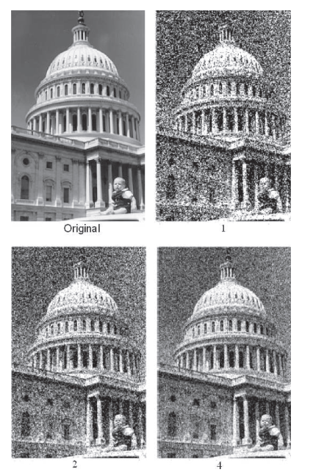
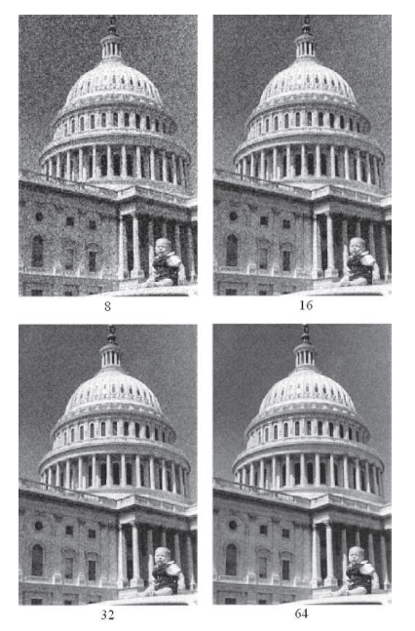
Averaging

Slide 12
